Slide 1
Even Functions
Odd Functions

Slide 2
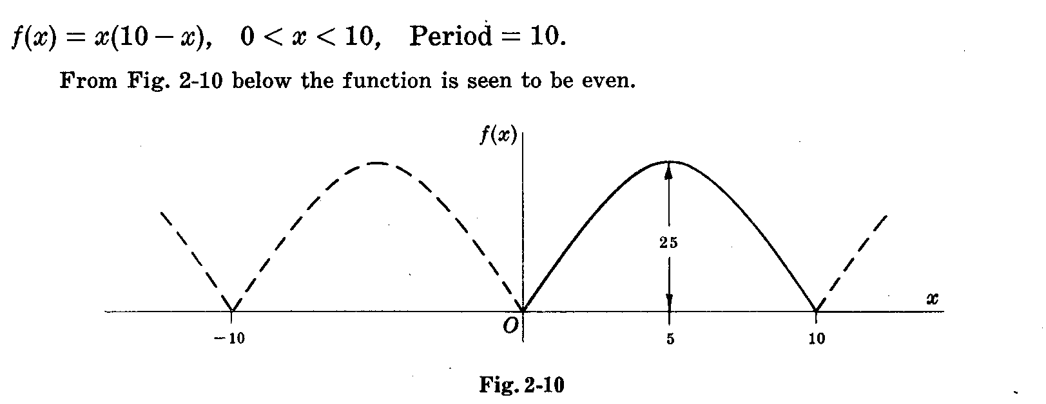

Slide 3
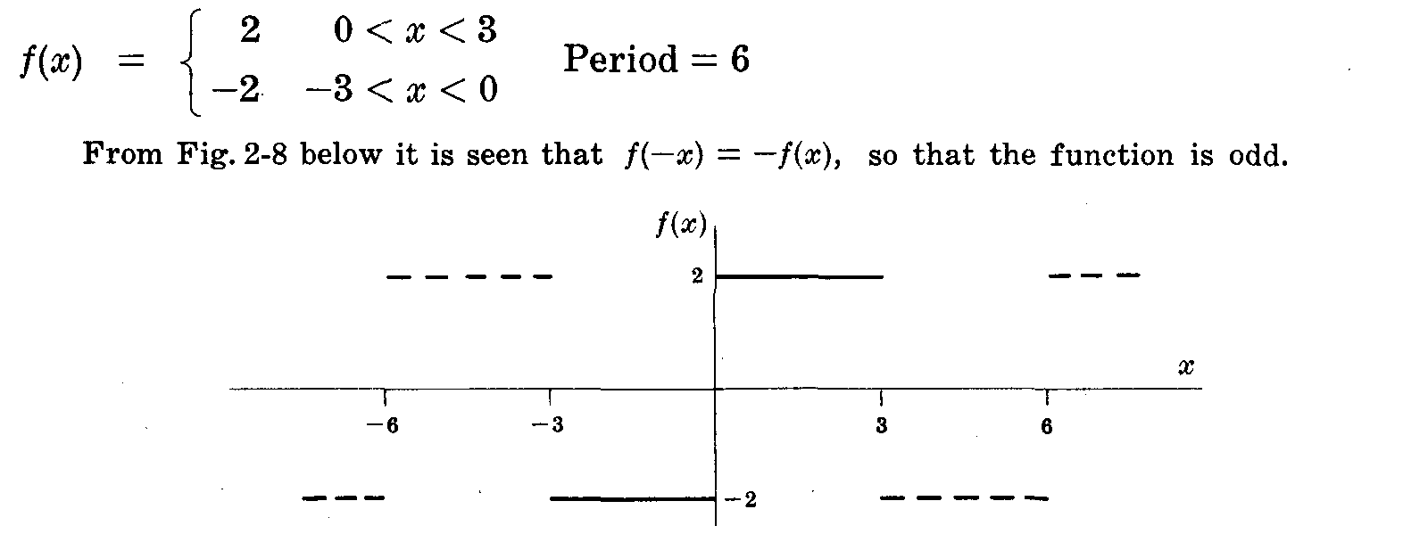

Slide 4
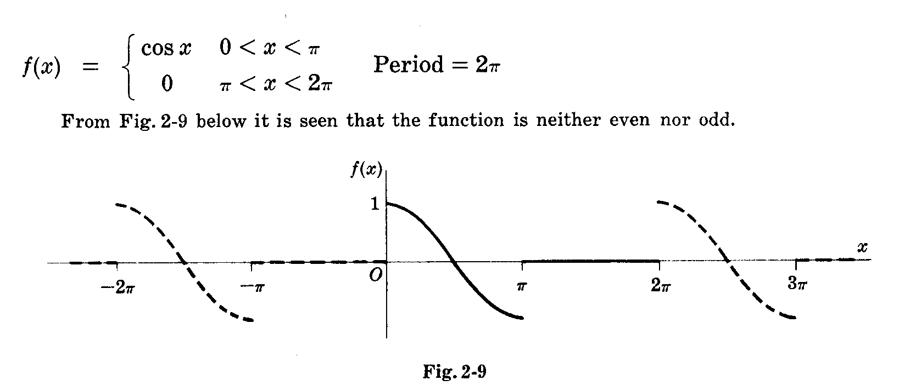

Slide 5
HALF-RANGE FOURIER SINE or COSINE series
A half- range Fourier sine or cosine series is a series in which only sine terms or only cosine terms are present, respectively. When a half-range series corresponding to a given function is desired, the function is generally defined in the interval (0,L) [which is half of the interval(-L,L), thus accounting for the name half-range] and then the function is specified as odd or even, so that it is clearly defined in the other half of the interval, namely(-L,0). In such case we have,
For half-range sine series with ODD function
For half-range Cosine series with EVEN function

Slide 6
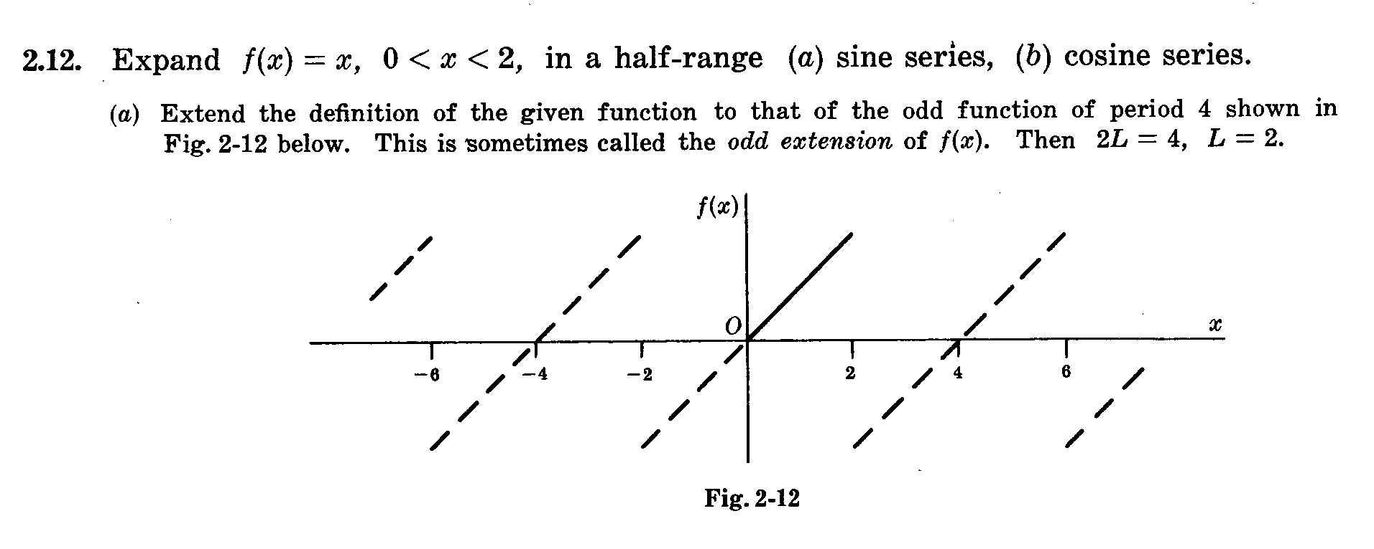

Slide 7
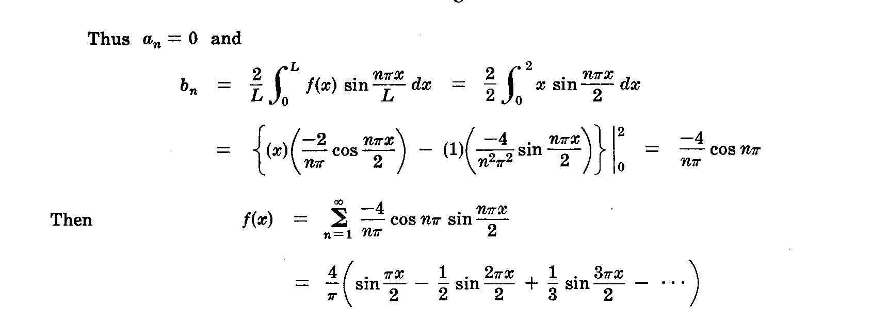

Slide 8
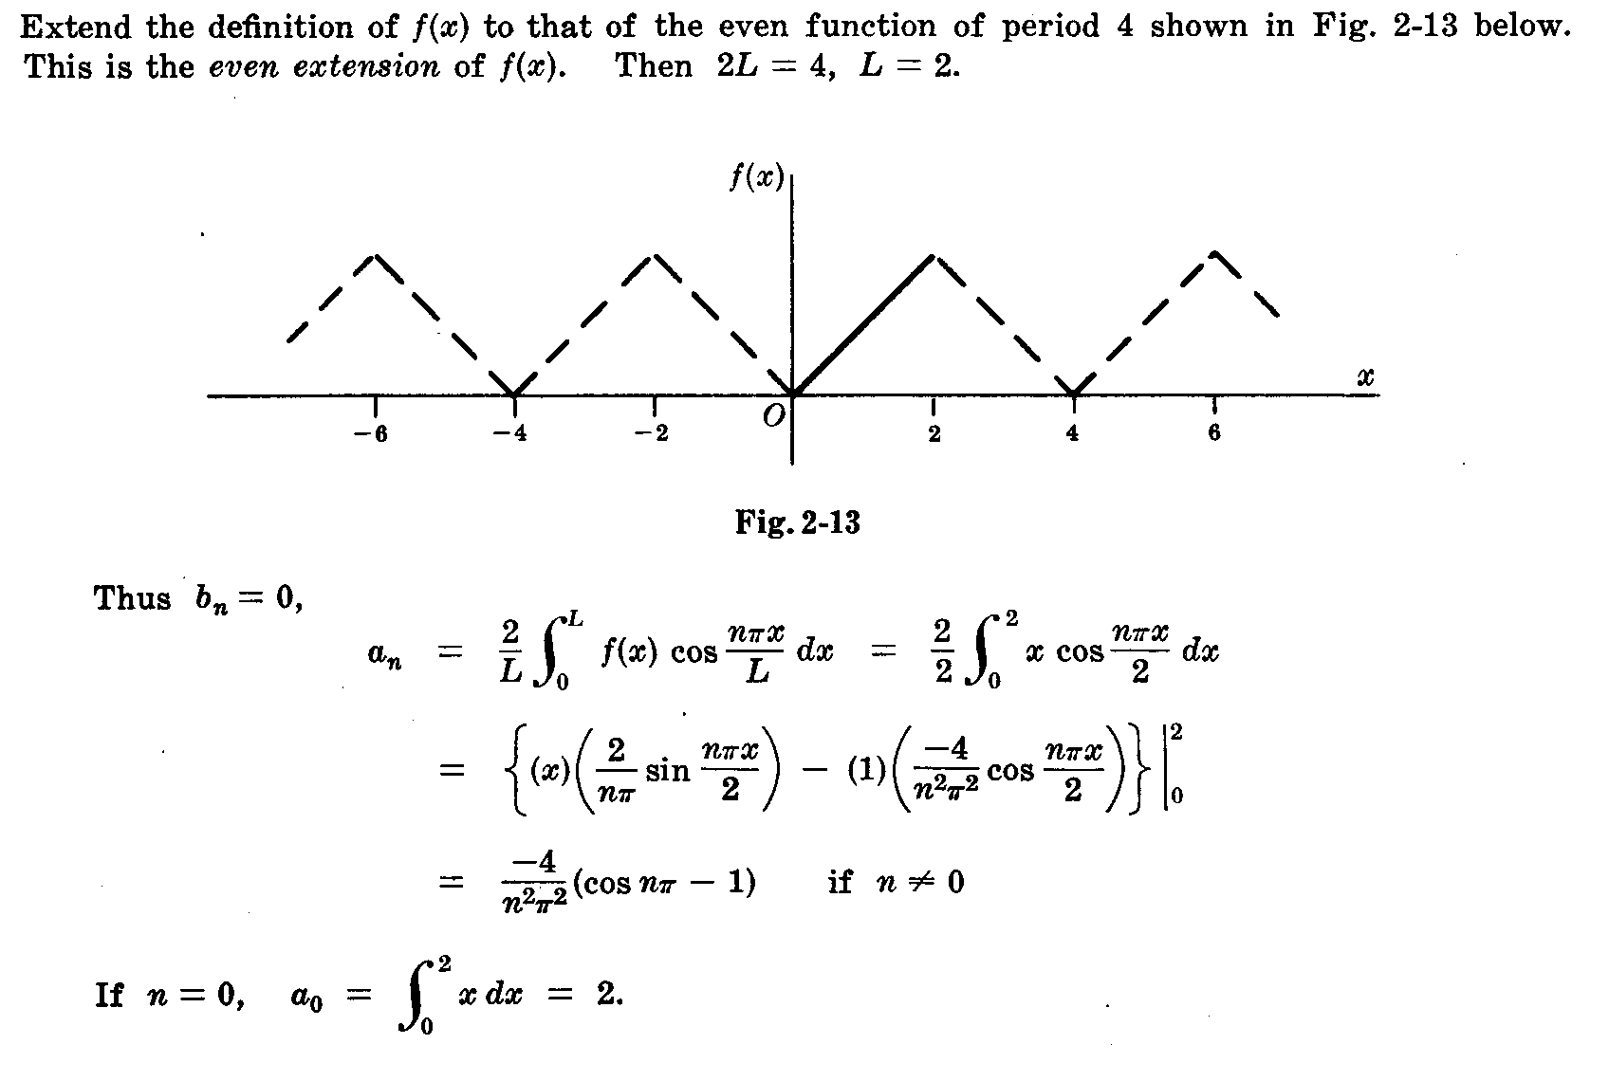

Slide 9
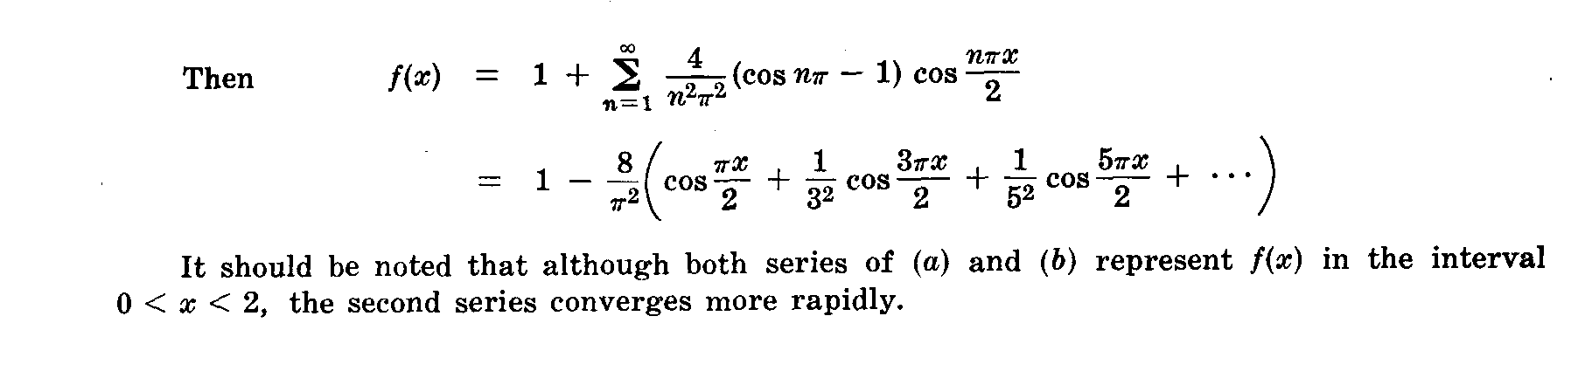

Slide 10
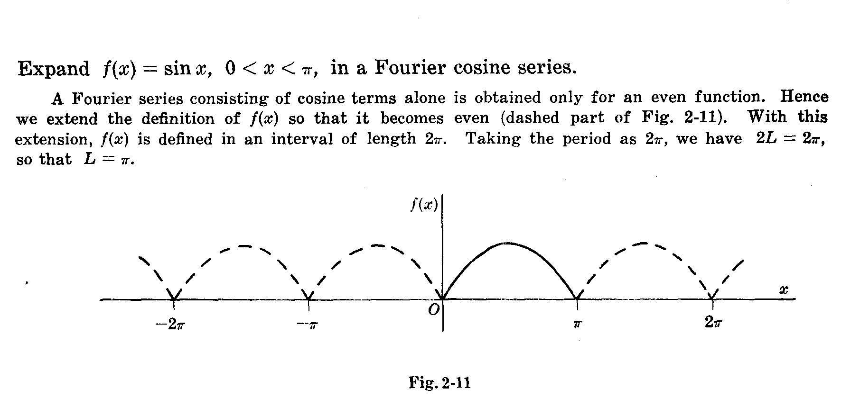

Slide 11
